Slide 1
PUBLIC HEALTH STUDENT ASSOCIATION
September 19th, 2016

Slide 2
AGENDA
Icebreaker
Housekeeping items (T-shirts, Groupme/FB, volunteer grant app., voting on social events
Social Media Campaign
Upcoming events
Tobacco-free petition
Public Health Spotlight

Slide 3
ICEBREAKER
Name Game
-Choose a public health word, phrase, idea etc. that starts with the same letter as your first name.
(ex. sanitation sally)

Slide 4
HOUSEKEEPING
Do we want T-shirts?
Groupme or FB for MPH students?
Apply for volunteering grant- need a project
Pick new social event! (mid-October)
Tobacco-free campus petition

Slide 5
TOBACCO-FREE CAMPUS?
Purdue University is exploring the option to become a tobacco-free campus. President Mitch Daniels, in collaboration with the Dean of the College of Pharmacy, want to gauge the student body’s point of view with the goal of demonstrating that the student body supports this initiative. They are reaching out to organizations to support the fight against tobacco and ultimately cancer, and other tobacco-related diseases.
They argue we should support this because:
• Tobacco is the leading preventable cause of death in the state of Indiana, claiming 11,100 lives each year and costing the state nearly $3 billion annually in healthcare costs.
Our ultimate goal is to achieve the CEO Gold Standard (a workplace accreditation program that encourages and recognizes the commitment of organizations that take concrete actions to address cancer in their workplaces)
*800 campuses across the nation have already become 100% tobacco-free!

Slide 6
SOCIAL MEDIA CAMPAIGN
National suicide prevention month– mental health
Week 1 (9/19): Tweet @PHSA a tip you use to help maintain a healthy mental state!
Week 2 (9/26): Post on the PHSA Facebook page a resource available for people struggling with suicidal thoughts.
Week 3 (10/3): Tweet @PHSA a suicide or mental health statistic.
Week 4 (10/10): Your choice to tweet, Instagram, post on Facebook, or blog anything related to mental health or suicide.
September 19th- October 15th

Slide 7
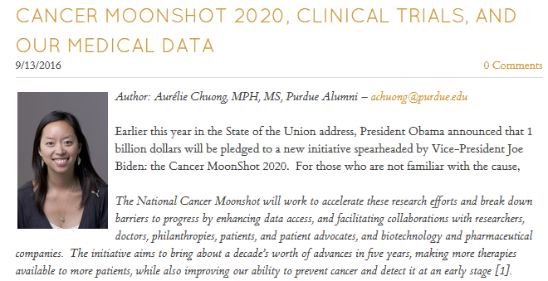

Slide 8
UPCOMING EVENTS
CCO Presentation: Job Fairs- Wednesday, 9/28 1PM Location: ARMS 1103
Walk to End Alzheimer's- Saturday, 10/1- 7am- 1:30pm Subaru of Indiana Automotive, 5500 State Road 38 East, Lafayette, IN 47905
Help in the kids zone
Face Painting, carnival games, helping plant forget-me-not flowers in honor of who they are walking for!
Come up with games to play!

Slide 9
UPCOMING EVENTS
Lafayette YWCA
Every Tuesday & Thursday- Tutoring 6-7:30PM
Child Care: M-F 6-7:30PM
Group projects: cleaning, sorting donations, etc. always needed
Long Term: Domestic Violence Hotline
Anytime of day
Requires 20 hours of training (16hrs of shadowing)
Contact Becky: rwellner@ywcalafayette.org if interested!

Slide 10
PUBLIC HEALTH SPOTLIGHT: Tobacco-use
In 2014, nearly 17 of every 100 U.S. adults aged 18 years or older (16.8%) currently smoked cigarettes. This means an estimated 40 million adults in the United States currently smoke cigarettes.
Cigarette smoking is the leading cause of preventable disease and death in the United States, accounting for more than 480,000 deaths every year, or 1 of every 5 deaths.
More than 16 million Americans live with a smoking-related disease.
-CDC
College student smoking rates hover around 20 percent
-IU Study

Slide 11
IU News Room
Study: Campus smoking ban reduced students' smoking, changed attitudes
-Dong-Chul Seo

Slide 12
What are the benefits of having a tobacco-free campus?

Slide 13
Benefits
-Less second-hand smoke (Improved health of nonsmokers)
-Improved health of tobacco users
-Reputation of tobacco-free
-Environmental/community cleanliness
-Prevention of incoming students becoming smokers

Slide 14
What are some perceived challenges or barriers to becoming a tobacco-free campus?

Slide 15
Challenges/Barriers
-Upset current smokers
-Personal freedom
-Defining parameters on which smoking is banned
-Establishing if/what other forms of smoking are allowed (e.g. e-cig, vaping)
-How will it be regulated/what is the punishment?

Slide 16
How can we help make the transition?

Slide 17
Facilitating the Transition
Provide education on cessation methods
Provide free smoking cessation programs to current smokers

Slide 18
Meeting #3
Wednesday, 10/5
12:30 PM
STON 144

