Slide 1
PUBLIC HEALTH STUDENT ASSOCIATION
Callout Meeting 8.29.2016

Slide 2
AGENDA
FOOD!
PHSA Mission
Membership
Icebreaker/Introductions
Recap of Last Year
Share your public health interests
Upcoming Events
Follow us on social media!

Slide 3
OUR MISSION
To promote an active community of Purdue graduate and undergraduate students who share a passion for the field of public health.

Slide 4
WHAT DOES PUBLIC HEALTH MEAN TO YOU?

Slide 5
WHAT IS PUBLIC HEALTH?
“Public health is the science of protecting and improving the health of families and communities through promotion of healthy lifestyles, research for disease and injury prevention and detection and control of infectious diseases.”
-CDC
https://www.apha.org/what-is-public-health

Slide 6
WHAT DOES BEING A MEMBER ENTAIL?
4 classroom meetings each semester
Will take place before or after journal club
Includes getting to know each other, discussing upcoming events and evaluating past events & a public health spotlight
A variety of social events, professional development events, and volunteer opportunities
Networking and meeting Purdue students with a shared passion

Slide 7
PARTICIPATION
BEING A MEMBER IS 100% VOLUNTARY, BUT YOUR PARTICIPATION DOES NOT GO UNNOTICED!
You will receive points for:
Attending meetings (1)
Attending events (2)
Participating in volunteering opportunites (2)
Helping out with events (preparing, planning, facilitating) (3)
Facilitating a public health spotlight (4)
Writing a blog post (3)
*Top 3 highest points will win a Purdue T-shirt or padfolio at the end of the semester! :)

Slide 8
ICEBREAKER
Write your name on a piece of paper & 2 random questions (you will be asking someone else these)
Make it into a paper airplane!

Slide 9
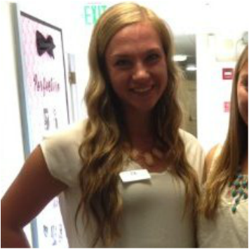
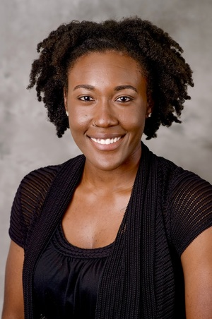
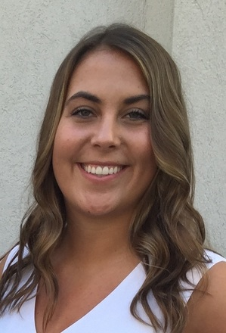
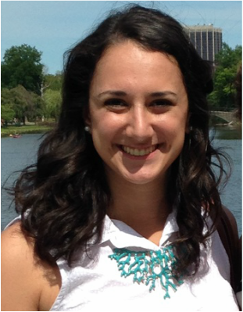
MEET THE OFFICERS
Madison Przydzial, Vice President B.S. in Public Health - Class of 2017
Hannah Letts, President Master of Public Health (Accelerated) - Class of 2017
Danelle Rolle, Treasurer Ph.D. Candidate in Occupational and Environmental Health Master of Public Health - Class of 2018
Elizabeth Wolff, Social Chair B.S. in Public Health - Class of 2018
Meredith Cervi, Secretary B.S. in Public Health - Class of 2018

Slide 10
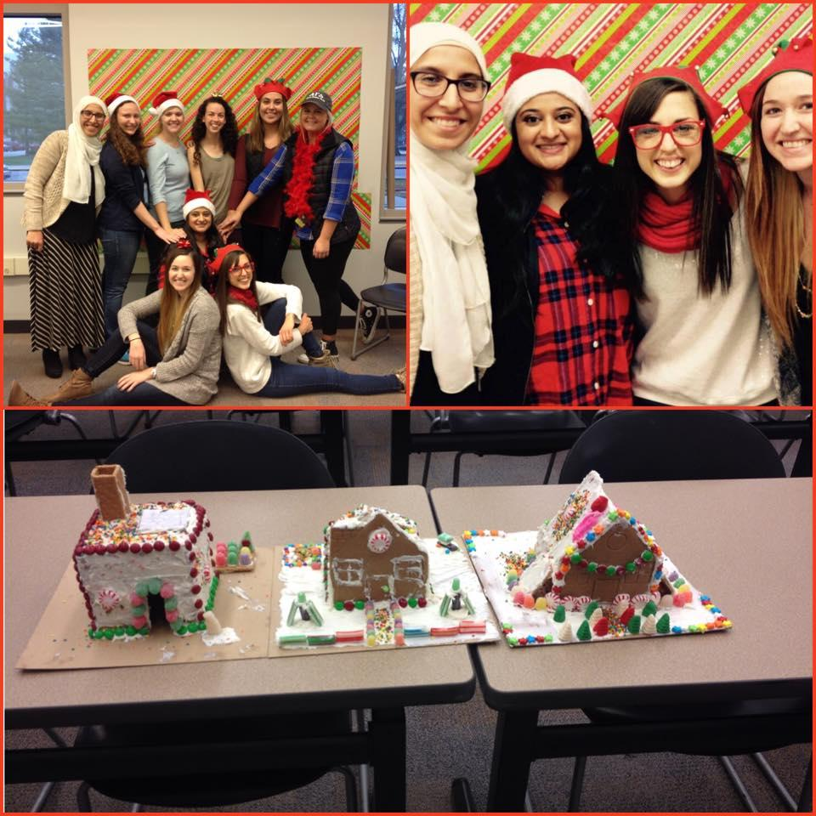
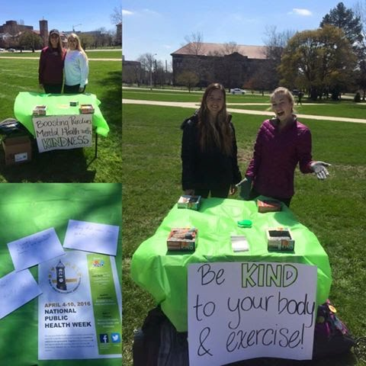
RECAP OF LAST YEAR
Get Involved Fair
Social Media Campaigns
Holiday Party
National Public
Health Week
Movie Screening- Hungry for Change
Common Read- Ghost Map

Slide 11
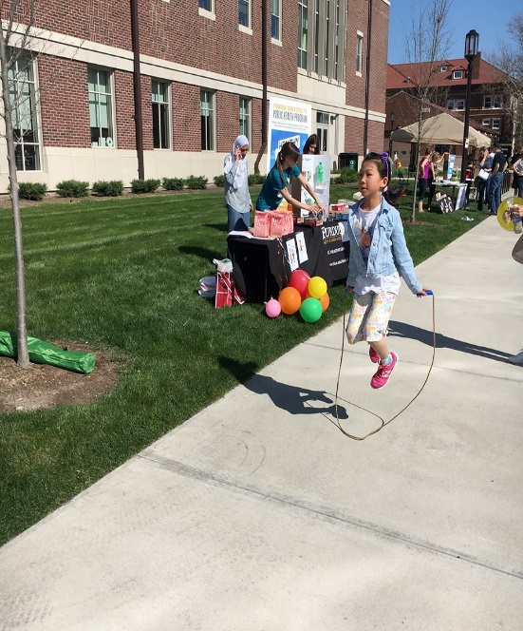
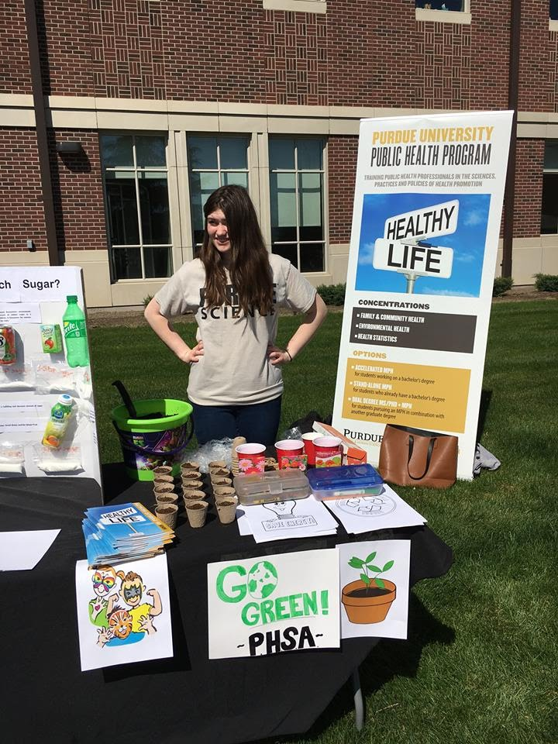
RECAP CONTINUED
Service Opportunities
American Cancer Society Walk
Lafayette Christmas Jubilee
Cooking baking & bingo at Westminster
Spring Fest
Public Health Spotlights
PHSA Blog Posts

Slide 12
WHAT ARE YOUR PUBLIC HEALTH INTERESTS?

Slide 13
UPCOMING EVENTS!
Boiler Challenge Course- Low Ropes: Sunday, 9/11 2-4 PM at the Co Rec
CCO Presentation: Job Fairs- Wednesday, 9/28 1PM Location: TBD
Walk to End Alzheimer's- Saturday, 10/1- 7am- 1:30pm Subaru of Indiana Automotive, 5500 State Road 38 East, Lafayette, IN 47905
Help in the kids zone
Face Painting, carnival games, helping plant forget-me-not flowers in honor of who they are walking for!
Come up with games to play!
YMCA- Every Tuesday
Tutoring, babysitting, working in the physical shelter
*Sign up now or via email

Slide 15
FOLLOW US ON SOCIAL MEDIA
Facebook.com/PurduePHSA
http://purduepublichealth.weebly.com/
@PurduePHSA
My Email:
letts@purdue.edu
@PurduePHSA

Slide 16
Meeting #2
Monday, 9/19
12:30 PM
KNOY B019

